Slide 1


Angular 6 Presentation Angular 6 Forms (Template Driven Forms and Reactive Forms)
Under Guidance of – Mr. Chary, Ravindra
By:-
Roshel Infan
Sankalp Khawade
Nitish Kumar Reddy Vintha
Hashwanth Alla

Slide 2
Contents
What is Angular Forms ?
Template Driven Forms or the Angular 1 Way
Reactive Forms or the new Functional Reactive Way
Difference between both Forms
Can and should the two be used together ?
Summary

Slide 3
What is Angular Forms ?

Slide 4
It is TypeScript-based open-source web application platform.
Forms are a vital part of any business application.
As developers, we need to handle data binding, change tracking, validation, visual feedback, error messages and of course form submission.
It creates an experience that guides the user efficiently and effectively through the workflow.

Slide 5
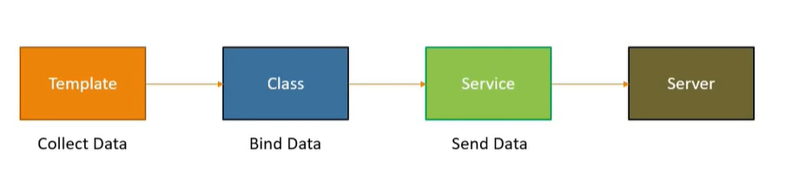
Angular Forms WorkFlow

Slide 6
Two Approaches
Template Driven Forms
- Heavy on the Component Template
Reactive Forms
- Heavy on the Component Class

Slide 7
Template Driven Forms or the Angular 1 Way

Slide 8
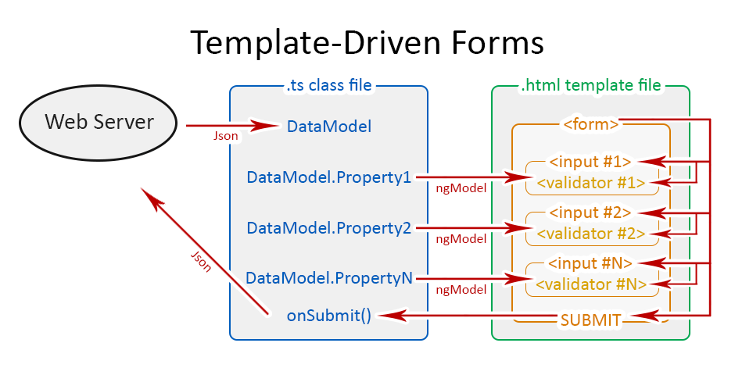

Slide 9
Advantages and Disadvantages
Two way binding is possible.
Template Driven Forms are asyncronous.
Although template forms are easier to create, they become a challenge when you want to do unit testing, because testing requires the presence of a DOM.

Slide 10
Reactive Forms or the new Functional Reactive Way

Slide 11
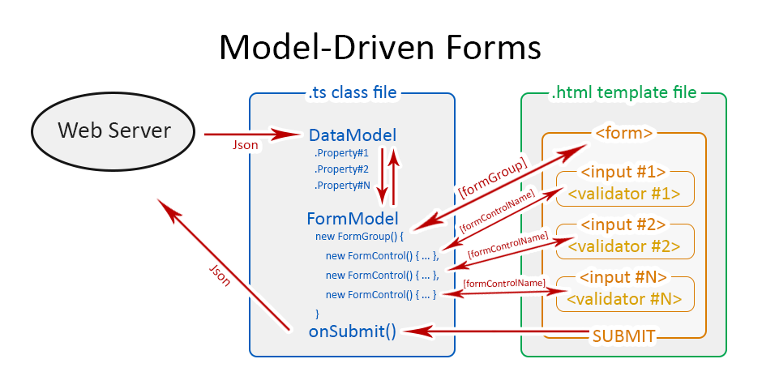

Slide 12
Advantages and Disadvantages
Reactive forms are synchronous.
No need of data-binding.
It's easier to write unit tests in reactive forms since all the form code and functionality is contained in the component.

Slide 13
Difference
Template Driven Forms
Reactive Forms
Template-driven forms make use of the "FormsModule“.
Template-driven forms are asynchronous in nature.
In a template-driven approach, most of the logic is driven from the template.
Two way binding is used.
Reactive forms are based on "ReactiveFormsModule".
Reactive forms are mostly synchronous.
In reactive-driven approach, the logic resides mainly in the component or typescript code.
No need of binding.

Slide 14
Can and should the two be used together ?

Slide 15
we could mix and match the two ways of building forms, for example:
we can use ngModel to read the data and use FormBuilder for the validations. we don't have to subscribe to the form or use RxJs if we don't wish to.
Declare a control in the controller, and then reference it in the template to obtain its validity state.

Slide 16
Summary
Angular provides with us ways to build forms: Template Driven and Reactive.
The Template Driven approach is very familiar to Angular 1 developers and is ideal for easy migration of Angular 1 applications into Angular.
The Reactive approach removes validation logic from the template, keeping the templates clean of validation logic. But also allows for a whole different way of building UIs that we can optionally use.
This is not an exclusive choice but for a matter of consistency, it's better to choose one of the two approaches and use it everywhere in our application.

Slide 17
Thank You

